Slide 1
Basic Relationships Between Pixels
• Neighborhood
• Adjacency
• Connectivity

Slide 2
Neighbors of a Pixel
• Any pixel p(x, y) has two vertical and two horizontal neighbors, given by (x+1, y), (x-1, y), (x, y+1), (x, y-1)
• This set of pixels are called the 4-neighbors of P, and is denoted by N₄(P).
• Each of them are at a unit distance from P.
• The four diagonal neighbors of p(x,y) are given by, (x+1, y+1), (x+1, y-1), (x-1, y+1), (x-1 ,y-1)
• This set is denoted by N _{D}(P).
• The points N_{D}(P) and N₄(P) are together known as 8-neighbors of the point P, denoted by N₈(P).
• Some of the points in the N₄, N_{D} and N₈ may fall outside image when P lies on the border of image.

Slide 3
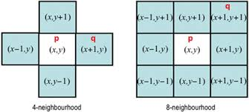
Neighbors of a pixel
4-neighbors of a pixel p are its vertical and horizontal neighbors
8-neighbors of a pixel p are its vertical horizontal and 4 diagonal neighbors

Slide 4
Adjacency between pixels
  Two pixels that are neighbors and have the same gray level are adjacent.
We consider three types of adjacency:
a) 4-adjacency: Two pixels p and q with values from V are 4-adjacent if q is in the set N4(p).
b) 8-adjacency: Two pixels p and q with values from V are 8-adjacent if q is in the set N8(p).
c) m-adjacency(mixed adjacency): Two pixels p and q with values from V are m-adjacent if
  q is in N4(p), or
  q is in ND(p) and the set N4(p)∩N4(q) has no pixels whose values are from V.

Slide 5
Connectivity between pixels
It is an important concept in digital image processing.
It is used for establishing boundaries of objects and components of regions in an image.
Two pixels are said to be connected:
if they are adjacent in some sense(neighbour pixels,4/8/m-adjacency)
if their gray levels satisfy a specified criterion of similarity(equal intensity level)
There are three types of connectivity on the basis of adjacency. They are:
  a) 4-connectivity: Two or more pixels are said to be 4-connected if they are 4-adjacent with each others.
  b) 8-connectivity: Two or more pixels are said to be 8-connected if they are 8-adjacent with each others.
  c) m-connectivity: Two or more pixels are said to be m-connected if they are m-adjacent with each others.

Slide 6
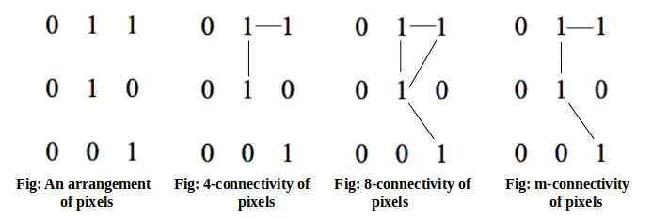
Connectivity between pixels (contd)

